Slide 1
Online Knowledge-Based
Support Vector Machines
Gautam Kunapuli¹, Kristin P. Bennett², Amina Shabbeer², Richard Maclin³ and Jude W. Shavlik¹
¹University of Wisconsin-Madison, USA
²Rensselaer Polytechnic Institute, USA
³University of Minnesota, Duluth, USA
TexPoint fonts used in EMF.
Read the TexPoint manual before you delete this box.: AAAAAAAAAAAAAAAAAAA

Slide 2
Outline
Knowledge-Based Support Vector Machines
The Adviceptron: Online KBSVMs
A Real-World Task: Diabetes Diagnosis
A Real-World Task: Tuberculosis Isolate Classification
Conclusions

Slide 3
Knowledge-Based SVMs
Introduced by Fung et al (2003)
Allows incorporation of expert advice into SVM formulations
Advice is specified with respect to polyhedral regions in input (feature) space
Can be incorporated into SVM formulation as constraints using advice variables

Slide 4
Knowledge-Based SVMs
In classic SVMs, we have T
labeled data points (x^{t}, y_{t}),
t = 1, …, T. We learn a linear
classifier w’x – b = 0.
Class A, y= +1
The standard SVM formulation
trades off regularization and loss:
Class B, y = -1

Slide 5
Knowledge-Based SVMs
We assume an expert provides
polyhedral advice of the form
Class A, y= +1
We can transform the logic constraint above using
advice variables, u
These constraints are added to the standard formulation to give Knowledge-Based SVMs
Class B, y = -1

Slide 6
Knowledge-Based SVMs
In general, there are m advice
sets, each with label ,
for advice belonging to
Class A or B,
Class A, y= +1
Each advice set adds the
following constraints to the
SVM formulation
Class B, y = -1

Slide 7
Knowledge-Based SVMs
The batch KBSVM formulation
introduces advice slack variables to soften the advice constraints
Class A, y= +1
Class B, y = -1

Slide 8
Outline
Knowledge-Based Support Vector Machines
The Adviceptron: Online KBSVMs
A Real-World Task: Diabetes Diagnosis
A Real-World Task: Tuberculosis Isolate Classification
Conclusions

Slide 9
Online KBSVMs
Need to derive an online version of KBSVMs
Algorithm is provided with advice and one labeled data point at each round
Algorithm should update the hypothesis at each step, w^{t}, as well as the advice vectors, u^{i,t}

Slide 10
Passive-Aggressive Algorithms
Adopt the framework of passive-aggressive algorithms (Crammer et al, 2006), where at each round, when a new data point is given,
  if loss = 0, there is no update (passive)
  if loss > 0, update weights to minimize loss (aggressive)
Why passive-aggressive algorithms?
  readily applicable to most SVM losses
  possible to derive elegant, closed-form update rules
  simple rules provide fast updates; scalable
  analyze performance by deriving regret bounds

Slide 11
Online KBSVMs
There are m advice sets,
At round t, the algorithm receives
The current hypothesis is , and the current advice variables are
At round t, the formulation for deriving an update is

Slide 12
Formulation At The t-th Round
There are m advice sets,
At round t, the algorithm receives
The current hypothesis is , and the current advice variables are
proximal terms for hypothesis and advice vectors

Slide 13
Formulation At The t-th Round
There are m advice sets,
At round t, the algorithm receives
The current hypothesis is , and the current advice variables are
data loss
advice loss

Slide 14
Formulation At The t-th Round
There are m advice sets,
At round t, the algorithm receives
The current hypothesis is , and the current advice variables are
parameters

Slide 15
Formulation At The t-th Round
There are m advice sets,
At round t, the algorithm receives
The current hypothesis is , and the current advice variables are
inequality constraints make deriving a closed-form update impossible

Slide 16
Formulation At The t-th Round
There are m advice sets,
At round t, the algorithm receives
The current hypothesis is , and the current advice-vector estimates are
DECOMPOSE INTO SMALLER SUBPROBLEMS
inequality constraints make deriving a closed-form update impossible

Slide 17
Decompose Into m+1 Sub-problems
First sub-problem: update hypothesis by fixing the advice variables, to their values at the t-th iteration
Some objective terms and constraints drop out of the formulation

Slide 18
Deriving The Hypothesis Update
First sub-problem: update hypothesis by fixing the advice vectors
Update advice vectors by fixing the hypothesis
  Breaks down into m sub-problems, one for each advice set

Slide 19
Deriving The Hypothesis Update
First sub-problem: update hypothesis by fixing the advice vectors
Update advice vectors by fixing the hypothesis
  Breaks down into m sub-problems, one for each advice set
fixed, advice-estimate of the hypothesis according to i-th advice set ; denote as

Slide 20
Advice-Estimate Of Current Hypothesis
First sub-problem: update hypothesis by fixing the advice vectors
Update advice vectors by fixing the hypothesis
  Breaks down into m sub-problems, one for each advice set
fixed, advice-estimate of the hypothesis according to i-th advice set ; denote as
average advice-estimates over all m advice vectors and denote as

Slide 21
The Hypothesis Update

Slide 22
The Hypothesis Update
Update is convex combination of the standard passive-aggressive update and the average advice-estimate
Parameter of convex combinations is

Slide 23
The Hypothesis Update
Update is convex combination of the standard passive-aggressive update and the average advice-estimate
Update weight depends on hinge loss computed with respect to a composite weight vector that is a convex combination of the current hypothesis and the average advice-estimate
Parameter of convex combinations is

Slide 24
Deriving The Advice Updates
Second sub-problem: update advice vectors by fixing the hypothesis
Some constraints and objective terms drop out of the formulation

Slide 25
Deriving The Advice Updates
Second sub-problem: update advice vectors by fixing the hypothesis

Slide 26
Deriving The Advice Updates
Second sub-problem: update advice vectors by fixing the hypothesis
split into m sub-problems

Slide 27
Deriving The i-th Advice Updates
m sub-problems: update the i-th advice vector by fixing the hypothesis

Slide 28
Deriving The i-th Advice Updates
m sub-problems: update the i-th advice vector by fixing the hypothesis
cone constraints still complicating
cannot derive closed form solution
Use projected-gradient approach
  drop constraints to compute intermediate closed-form update
  project intermediate update back on to cone constraints

Slide 29
The m Advice Updates

Slide 30
The m Advice Updates
projection
hypothesis-estimate of the advice; denote
The update is the error or the amount of violation of the constraint by an ideal data point,
each advice update depends on the newly updated hypothesis

Slide 31
The Adviceptron

Slide 32
Outline
Knowledge-Based Support Vector Machines
The Adviceptron: Online KBSVMs
A Real-World Task: Diabetes Diagnosis
A Real-World Task: Tuberculosis Isolate Classification
Conclusions

Slide 33
Diagnosing Diabetes
Standard data set from UCI repository (768 x 8)
  all patients at least 21 years old of Pima Indian heritage
  features include body mass index, blood glucose level
Expert advice for diagnosing diabetes from NIH website on risks for Type-2 diabetes
  a person who is obese (characterized by BMI > 30) and has a high blood glucose level (> 126) is at a strong risk for diabetes
  a person who is at normal weight (BMI < 25) and has low blood glucose level (< 100) is at a low risk for diabetes

Slide 34
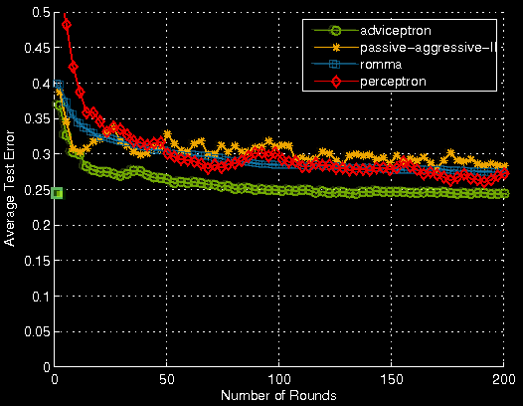
Diagnosing Diabetes: Results
200 examples for training, remaining for testing
Results averaged over 20 randomized iterations
Compared to advice-free
online algorithms:
  Passive-aggressive (Crammer et al, 2006),
  ROMMA
  (Li & Long, 2002),
  Max margin-perceptron
  (Freund & Schapire, 1999)
batch KBSVM, 200 points

Slide 35
Outline
Knowledge-Based Support Vector Machines
The Adviceptron: Online KBSVMs
A Real-World Task: Diabetes Diagnosis
A Real-World Task: Tuberculosis Isolate Classification
Conclusions

Slide 36
Tuberculosis Isolate Classification
Task is to classify strains of Mycobacterium tuberculosis complex (MTBC) into major genetic lineages based on DNA fingerprints
MTBC is the causative agent for TB
  leading cause of disease and morbidity
  strains vary in infectivity, transmission, virulence, immunogenicity, host associations depending on genetic lineage
Lineage classification is crucial for surveillance, tracking and control of TB world-wide

Slide 37
Tuberculosis Isolate Classification
Two types of DNA fingerprints for all culture-positive TB strains collected in the US by the CDC (44 data features)
Six (classes) major lineages of TB for classification
  ancestral: M. bovis, M. africanum, Indo-Oceanic
  modern: Euro-American, East-Asian, East-African-Indian
Problem formulated as six 1-vs-many classification tasks

Slide 38
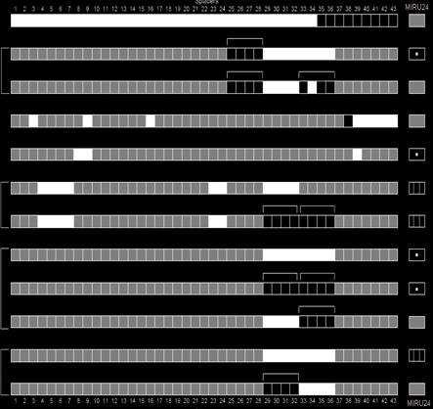
Expert Rules for TB Lineage Classification
East-Asian
Indo-Oceanic
M. bovis
M. africanum
East-African-Indian
Indo-Oceanic
Euro-American
Rules provided by Dr. Lauren Cowan at the Center for Disease Control, documented in Shabbeer et al, (2010)

Slide 39
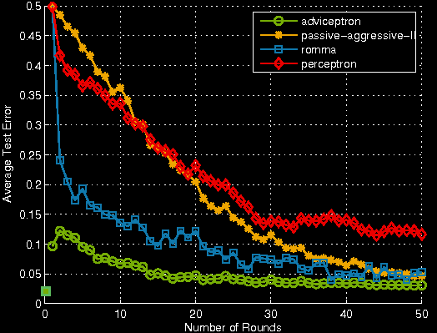
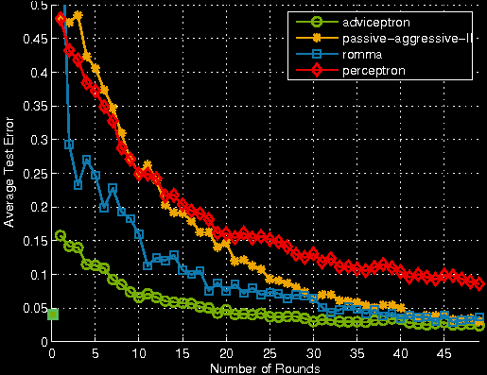
TB Results: Might Need Fewer Examples To Converge With Advice
Euro-American vs. the Rest
M. africanum vs. the Rest
batch KBSVM
batch KBSVM

Slide 40
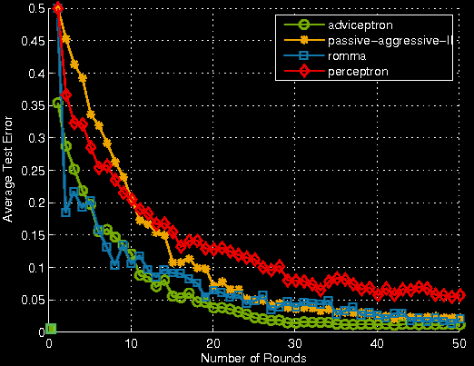
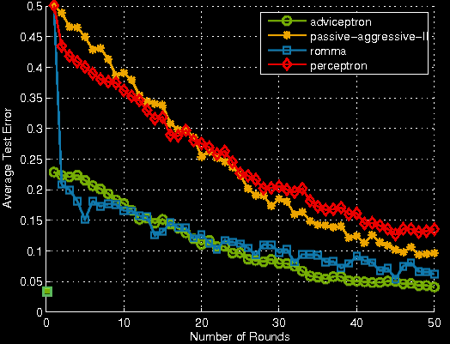
TB Results: Can Converge To A Better Solution With Advice
East-African-Indian vs. the Rest
Indo-Oceanic vs. the Rest
batch KBSVM
batch KBSVM

Slide 41
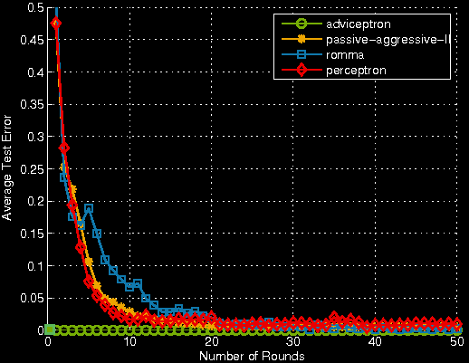
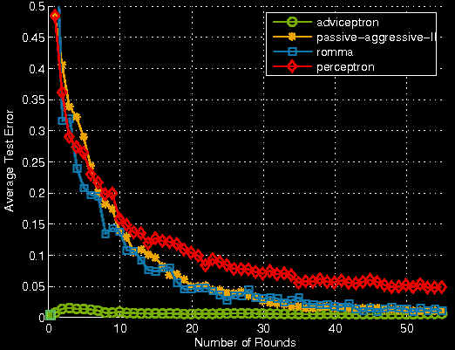
TB Results: Possible To Still Learn Well With Only Advice
East-Asian vs. the Rest
M. bovis vs. the Rest
batch KBSVM
batch KBSVM

Slide 42
Outline
Knowledge-Based Support Vector Machines
The Adviceptron: Online KBSVMs
A Real-World Task: Diabetes Diagnosis
A Real-World Task: Tuberculosis Isolate Classification
Conclusions And Questions

Slide 43
Conclusions
New online learning algorithm: the adviceptron
Makes use of prior knowledge in the form of (possibly imperfect) polyhedral advice
Performs simple, closed-form updates via passive-aggressive framework; scalable
Good advice can help converge to a better solution
with fewer examples
Encouraging empirical results on two important
real-world tasks

Slide 44
References.
(Fung et al, 2003) G. Fung, O. L. Mangasarian, and J. W. Shavlik. Knowledge-based support vector classifiers. In S. Becker, S. Thrun & K. Obermayer, eds, NIPS, 15, pp. 521–528, 2003
(Crammer et al, 2006) K. Crammer, O. Dekel, J. Keshet, S. Shalev-Shwartz, and Y. Singer. Online passive-aggressive algorithms. J. of Mach. Learn. Res., 7:551–585, 2006.
(Freund and Schapire, 1999) Y. Freund and R. E. Schapire. Large margin classification using the perceptron algorithm. Mach. Learn., 37(3):277–296, 1999.
(Li and Long, 2002) Y. Li and P. M. Long. The relaxed online maximum margin algorithm. Mach. Learn., 46(1/3):361–387, 2002.
(Shabbeer et al, 2001) A. Shabbeer, L. Cowan, J. R. Driscoll, C. Ozcaglar, S. L Vandenberg, B. Yener, and K. P Bennett. TB-Lineage: An online tool for classification and analysis of
strains of Mycobacterium tuberculosis Complex. Unpublished manuscript, 2010.
Acknowledgements.
The authors would like to thank Dr. Lauren Cowan of the Center for Disease Control (CDC) for providing the TB dataset and the expert-defined rules for lineage classification.
We gratefully acknowledge support of DARPA under grant HR0011-07-C-0060 and the NIH under grant 1-R01-LM009731-01.
Views and conclusions contained in this document are those of the authors and do not necessarily represent the official opinion or policies, either expressed or implied of the US government or of DARPA.

Slide 45
KBSVMs: Deriving The Advice Constraints
We assume an expert provides
polyhedral advice of the form
Class A, y= +1
We know is equivalent
to
If has a solution then its negation has no solution or,
Class B, y = -1
has no solution

Slide 46
KBSVMs: Deriving The Advice Constraints
If the following system
Class A, y= +1
has no solution , then by
Motzkin’s Theorem of the
Alternative, the following system
has a solution u.
Class B, y = -1

