Slide 1
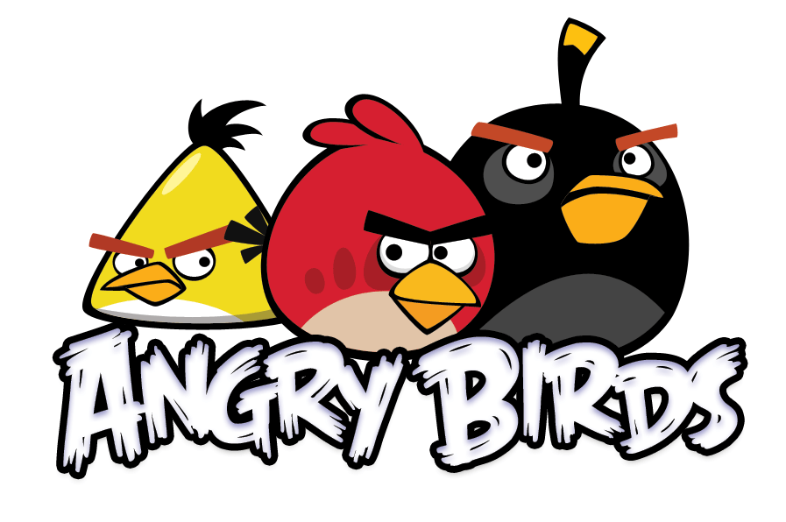
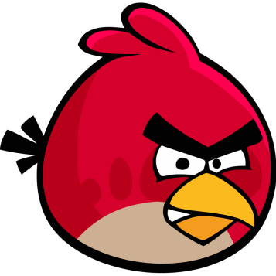
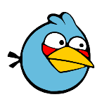
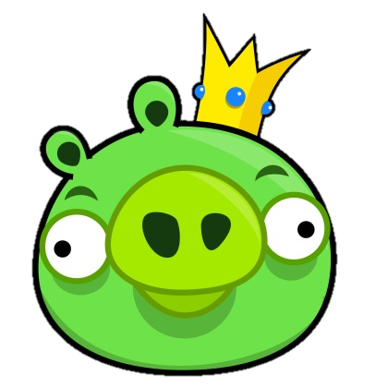
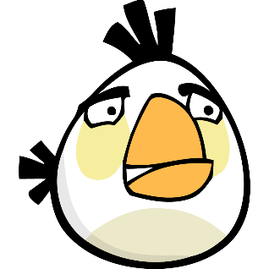
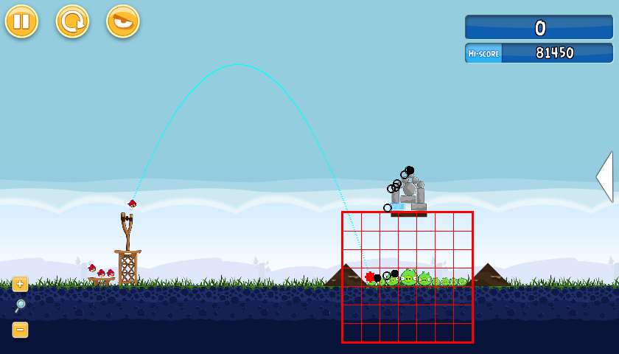
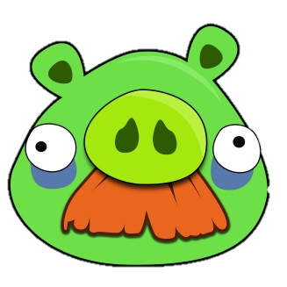
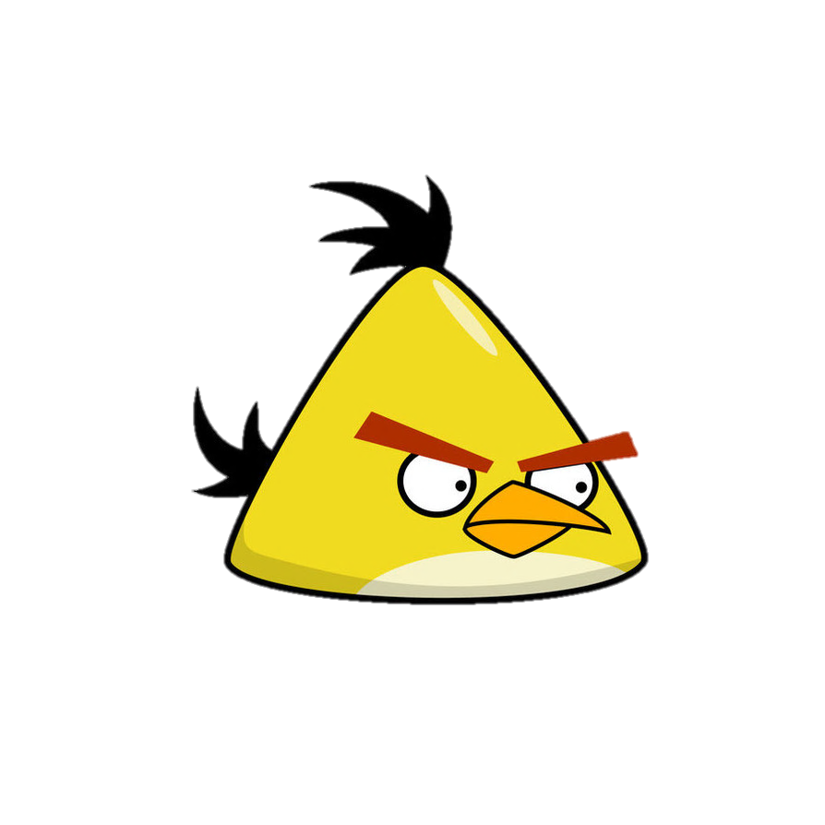
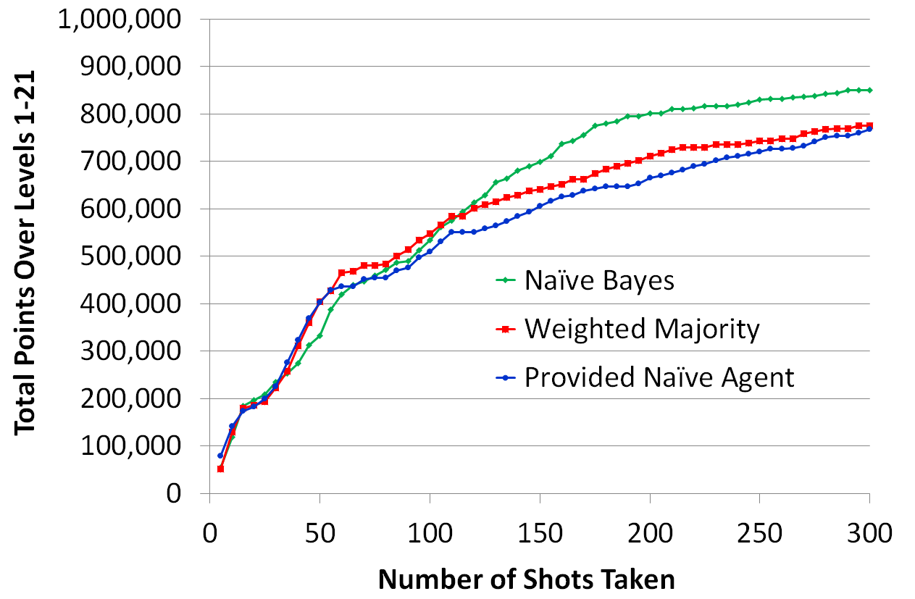
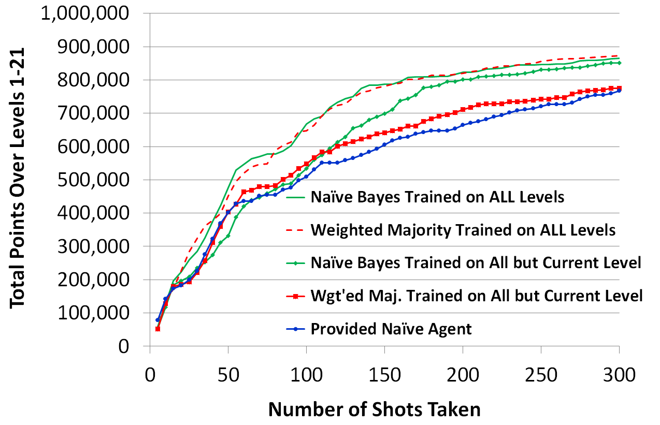
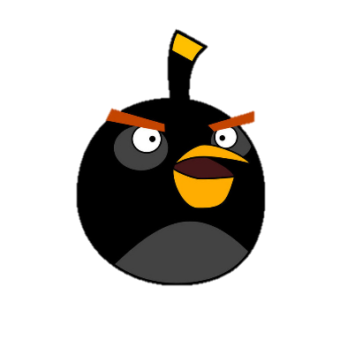
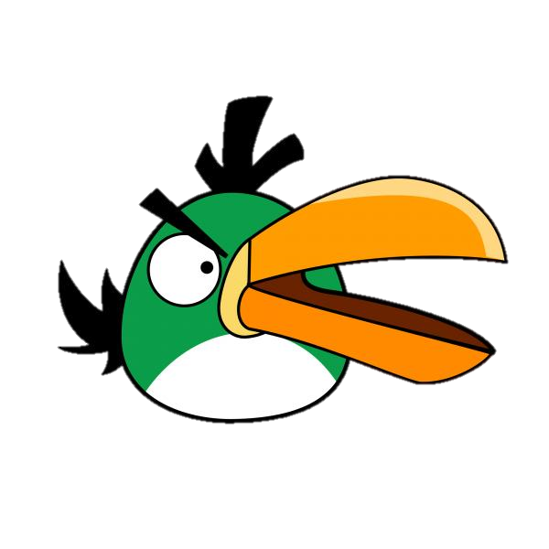
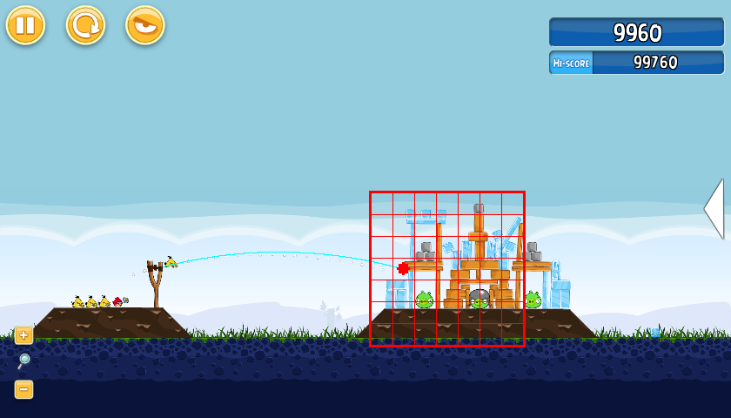
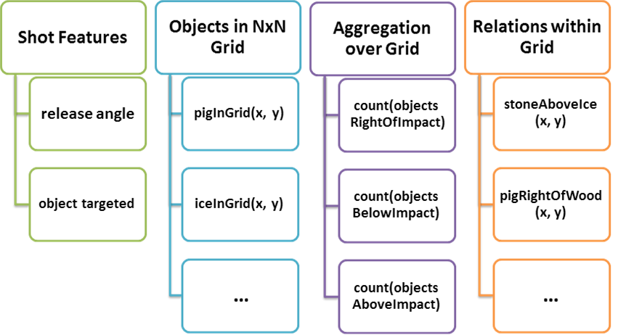
An Empirical Evaluation of Machine Learning Approaches for Angry Birds
Anjali Narayan-Chen, Liqi Xu, and Jude Shavlik
University of Wisconsin-Madison
narayanchen@wisc.edu, lxu36@wisc.edu, shavlik@cs.wisc.edu Poster presented at the IJCAI 2013 Symposium on AI in Angry Birds.
Team TeamWisc placed 3rd out of 20 competitors in the IJCAI 2013 Angry Birds AI Competition.
Abstract
3b. Approach: Data Collection and Filtering
Angry Birds is a popular video game in which players shoot birds at pigs and other objects. Because of complexities in Angry Birds, such as continuously-valued features, sequential decision making, and the inherent randomness of the physics engine, learning to play Angry Birds intelligently presents a difficult challenge for machine learning. We describe how we used the Weighted Majority Algorithm and Naïve Bayesian Networks to learn how to judge possible shots. A major goal of ours is to design an approach that learns the general task of playing Angry Birds rather than learning how to play specific levels. A key aspect of our design is that the features provided to the learning algorithms are a function of the local neighborhood of a shot’s expected impact point. To judge generality we evaluate the learning algorithms on game levels not seen during training. Our empirical study shows our learning approaches can play statistically significantly better than a baseline system provided by the organizers of the Angry Birds competition.
Challenge: getting enough good shots
Use provided NaiveAgent and our RandomAngleAgent
Also use our TweakMacrosAgent to explore the neighborhood of successful games
Each agent runs on a number of machines, either directly or through remote connection
Furthermore, we filter our collected data to guard against negative skew of data
Training data of shots
(collected via NaiveAgent, RandomAngleAgent, and TweakMacrosAgent)
Positive examples (shots in winning games)
Negative examples (shots in losing games)
Discard ambiguous examples (in losing game, but killed pig)
Discard examples with bad tap times
(thresholds provided by TapTimeIntervalEstimator)
Discard duplicate examples
(first shots whose angles differ by < 10⁻⁵ radians)
For additional details, see “An Empirical Evaluation of Machine Learning Approaches for Angry Birds”, A. Narayan-Chen, L. Xu, and J. Shavlik,
Proc. IJCAI-2013 Symp. on AI in Angry Birds, http://ftp.cs.wisc.edu/machine-learning/shavlik-group/narayanchen.ijcai13.pdf
Keep approximately 50-50 mixture of positive and negative examples per level
1. The Angry Birds Task
4. Experimental Methodology
Need to make four decisions:
Shot angle
Shot strength
Tap time
Delay after shot
We focus on choosing shot angle, while maintaining maximum shot strength and a constant wait period of 10 seconds after shot. Tap time is handled by finding ranges in training data (per bird type) that performed well.
We are given the NaiveAgent provided by the IJCAI 2013 Angry Birds AI competition, which we use as an experimental control.
Detects the slingshot and other objects and shoots at randomly chosen pigs
Trajectories are randomly chosen between high-arching shots (release angle ≥ 45°) and direct shots (angle < 45°), with a preference towards direct shots
Uses predetermined tap-time intervals for both types of shots
We train our algorithms on training and tuning sets created from our filtered dataset
For every game state, we consider several dozen candidate shots (see fig. to right), considering both high- and straight-angled shots for each potential target
Each candidate shot is presented as a grid example to be evaluated by the learning algorithm being tested
Weighted Majority Algorithm returns a net weighted sum score
Naïve Bayesian Network returns a calculation of the odds of winning given the features present in the grid example
We then consider the five highest-scoring candidate shots, choosing among them proportionally to each of their scores
Each model trained on training examples from all levels except the level it would be used to play
We start Chrome instances with all Angry Birds levels (1-21) unlocked
First, from 1 to 21, play each level once
Next, again from 1 to 21, play once those levels not yet solved; repeat until all levels solved
When all levels solved, play the level with the best ratio of number of times a new high score was set over number of times level was played
2. Background: Algorithms Used
5. Results
Weighted Majority Algorithm
(Littlestone, MLj, 1988)
Naïve Bayesian Networks
(Russell and Norvig, 2010)
Uses a pool of prediction algorithms to build an efficient compound algorithm
Evaluates examples by taking a weighted vote among the members of this pool
Learns by altering the hypotheses’ associated weights when it makes mistakes
Encodes a directed, acyclic graph with conditional independence relations among variables
Dependent class variable $Y$ is the root and feature variables $X_{1}$ through $X_{n}$ are conditioned by Y’s value
Naïve (yet effective) assumption is that each feature $X_{i}$ is conditionally independent of every other feature $X_{j}$for $j≠i$ given $Y$
Our approach:
Learning simply involves counting the examples’ features to estimate simple probabilities
For Angry Birds, the Y is goodShot and the X’s are the features used to describe the game’s state and the shot angle
For each feature, we compute the probability that it is present for both goodShot and badShot; the ratio of these probabilities is the score of a candidate shot
Given a pool A of algorithms, where a_{i} is the i^{th} prediction algorithm; w_{i}, where w_{i} ≥ 0, is the associated weight for a_{i}; and β is a scalar < 1:
Initialize all weights to 1
For each example in the training set {x, f(x)}
Initialize y₁ and y₂ to 0
For each prediction algorithm a_{i},
If a_{i}(x) = 0 then y₁ = y₁ + w_{i}
Else if a_{i}(x) = 1 then y₂ = y₂ + w_{i}
If y1 > y2 then g(x) = 1
Else if y1 < y then g(x) = 0
Else g(x) is assigned to 0 or 1 randomly.
If g(x) ≠ f(x) then for each pred. alg. a_{i}
If a_{i}(x) ≠ f(x) then update w_{i} with βw_{i}.
The performance of our learning algorithms and of our experimental control as a function of the number of shots taken versus the sum of the highest scores for each of the 21 levels (only scores in winning games are counted). We play 300 shots, which takes about 75 minutes. The results are averaged over ten repeated runs. Both our learning methods perform better than our experimental control, the provided NaiveAgent.
The performance of our learning algorithms when we use a single model trained on all 21 levels to play all the levels. This figure shows the difference in performance when the learners have the advantage of playing each level many times before being evaluated. Using an unpaired two-tailed t-test, the differences between the NaiveAgent are statistically significant for all but WMA (p-values of less than 0.0001 for the two versions trained on all levels and p= 0.01 for NB).
3a. Approach: Representing Training Examples
6. Conclusion and Future Work
Task to Learn
Good shots: those from games won
Bad shots: shots in games lost, except those that killed pig
Goal: have a representation that is independent of level
AngryBirdsGridExample: represents localized portion of game state as a 7x7 grid of cells located around impact point
Figures to the right:
Visualization of the AngryBirdsGridExample grid
Chart of features we use to represent examples
In the future, we may explore:
More machine learning approaches, such as reinforcement learning
Improved definitions of good and bad shots
Separate models for different types of birds and shots
Moving beyond naïve Bayesian networks by designing Bayesian networks with dependencies among features, either manually or through algorithmic search
Exploiting human-provided demonstrations of good solutions
In conclusion: Angry Birds testbed serves as a challenging problem for machine learning
Our learning algorithms are able to statistically significantly outperform the provided NaiveAgent
Our empirical results provide a baseline for the performance of future machine learning (and other AI) methods
We argue that the primary goal should be to learn the general task of playing Angry Birds, rather than aiming to learn how to play specific levels
This can be addressed by making sure models for choosing shots for Level i are not trained with any examples from Level i

