Slide 1
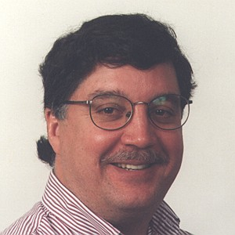

Speeding Up Inference in Markov Logic Networks by Preprocessing to Reduce the Size of the Resulting Grounded Network
Jude Shavlik
Sriraam Natarajan
Computer Sciences Department
University of Wisconsin, Madison USA

Slide 2

Markov Logic Networks
(Richardson & Domingos, MLj 2006)
A probabilistic, first-order logic
Key idea
compactly represent large graphical models
using weight = w ∀ x, y, z f(x, y, z)
Standard approach
1) assume finite number of constants
2) create all possible groundings
3) perform statistical inference (often via sampling)

Slide 3
The Challenge We Address
Creating all possible groundings
can be daunting
A story …
Given: an MLN and data
Do: quickly find an equivalent,
reduced MLN

Slide 4
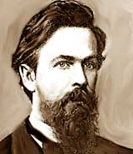
Computing Probabilities in MLNs
Probability( World S )
= ( 1 / Z ) ×
exp { Σ weight _{i} x numberTimesTrue(f _{i}, S) }
i ∈ formulae

Slide 5
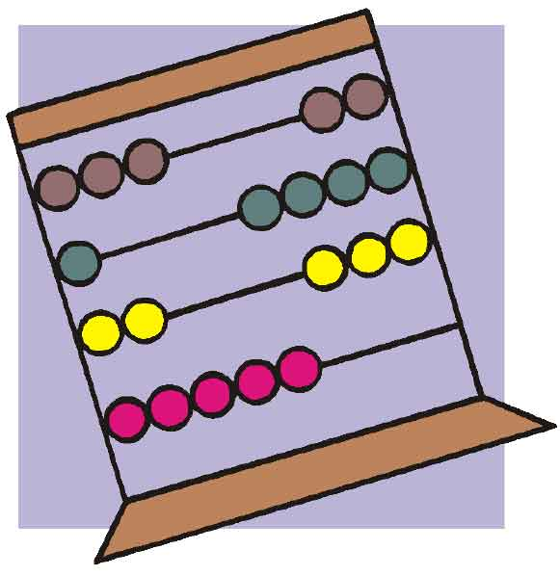
Counting Satisfied Groundings
Typically lots of redundancy in FOL sentences
∀ x, y, z p(x) ⋀ q(x, y, z) ⋀ r(z) → w(x, y, z)
If p(John) = false,
then formula = true
for all Y and Z values

Slide 6

Some Terminology
  Three kinds of literals (‘predicates’)
  Evidence: truth value known
  Query: want to know prob’s of these
  Hidden: other

Slide 7
Factoring Out the Evidence
  Let A = weighted sum of formula
  satisfied by evidence
  Let B_{i} = weighted sum of formula in world i
  not satisfied by evidence
  Prob(world i ) =
e ^{Bi}
e ^{A + Bi}
e ^{B1} + … + e ^{Bn}
e ^{A + B1} + … + e ^{A + Bn}

Slide 8
Key Idea of Our
FROG Algorithm
Efficiently factor out those formula groundings that evidence satisfies
  Can produce many orders-of-magnitude smaller Markov networks
  Can eliminate need for approximate inference,
  if resulting Markov net small/disconnected enough
  Resulting Markov net compatible with other speed-up methods, such as lifted and lazy inference, knowledge-based model construction

Slide 9
Worked Example
∀ x, y, z GradStudent(x) ⋀ Prof(y) ⋀ Prof(z) ⋀ TA(x, z) ⋀ SameGroup(y, z)
→ AdvisedBy(x, y)
10,000 People at some school
2000 Graduate students
1000 Professors
1000 TAs
500 Pairs of professors in the same group
The Evidence
Total Num of Groundings = |x| × |y| × |z| = 10¹²
10¹²

Slide 10
GradStudent(x) ⋀ Prof(y) ⋀ Prof(z) ⋀ TA(x,z) ⋀ SameGroup(y,z) → AdvisedBy(x,y)
FROG keeps only these X values
GradStudent(P1)
GradStudent(P3)
…
2000
Grad Students
GradStudent(x)
True
GradStudent(P1)
¬ GradStudent(P2)
GradStudent(P3)
…
¬ GradStudent(P2)
¬ GradStudent(P4)
…
8000
Others
False
All these values for X satisfy the clause, regardless of Y and Z
10¹²
2 × 10¹¹
Instead of 10⁴ values for X,
have 2 x 10³

Slide 11
GradStudent(x) ⋀ Prof(y) ⋀ Prof(z) ⋀ TA(x,z) ⋀ SameGroup(y,z) → AdvisedBy(x,y)
Prof(P2)
…
1000
Professors
Prof(y)
True
¬ Prof(P1)
Prof(P2)
…
False
¬ Prof(P1)
…
9000
Others
2 × 10¹¹
2 × 10¹⁰

Slide 12
GradStudent(x) ⋀ Prof(y) ⋀ Prof(z) ⋀ TA(x,z) ⋀ SameGroup(y,z) → AdvisedBy(x,y)
<<< Same as Prof(y) >>>
2 × 10¹⁰
2 × 10⁹

Slide 13
GradStudent(x) ⋀ Prof(y) ⋀ Prof(z) ⋀ TA(x,z) ⋀ SameGroup(y,z) → AdvisedBy(x,y)
SameGroup(P1, P2)
…
1000 true
SameGroup’s
SameGroup(y, z)
True
10⁶ Combinations
¬ SameGroup(P2, P5)
…
10⁶ – 1000
Others
False
2000 values of X
1000 Y:Z combinations
2 × 10⁹
2 × 10⁶

Slide 14
GradStudent(x) ⋀ Prof(y) ⋀ Prof(z) ⋀ TA(x,z) ⋀ SameGroup(y,z) → AdvisedBy(x,y)
TA(P7,P5)
…
1000
TA’s
TA(x, z)
True
2 × 10⁶ Combinations
¬ TA(P8,P4)
…
2 × 10⁶ – 1000
Others
False
≤ 1000 values of X
≤ 1000 Y:Z combinations
≤ 10⁶

Slide 15
GradStudent(x) ⋀ Prof(y) ⋀ Prof(z) ⋀ TA(x,z) ⋀ SameGroup(y,z) → AdvisedBy(x,y)
10¹²
Original number of groundings = 10¹²
10⁶
Final number of groundings ≤ 10⁶

Slide 16

Some Algorithmic Details
Initially store 10 ¹² groundings with 10 ⁴ space
Storage needs grow because literals
cause variables to ‘interact’
  P(x, y, z) might require O(10¹²) space
Order literals ‘reduced’ impacts storage needs
  Simple heuristic (see paper) chooses
  literal to process next – or try all permutations
Can merge inference rules after reduction
  After reduction, sample rule only has advisedBy(x,y)

Slide 17
Empirical Results: CiteSeer
Fully Grounded Net
FROG’s Reduced Net

Slide 18
Empirical Results: UWash-CSE
Fully Grounded Net
FROG’s Reduced Net
FROG’s Reduced Net without One Challenging Rule
advisedBy(x,y) ∧ advisedBy(x,z) → samePerson(y,z))

Slide 19
Runtimes
On Full UWash-CSE (27 rules)
  FROG takes 4.2 sec
On CORA (2K rules) and CiteSeer (8K rules)
  FROG takes less than 700 msec per rule
On CORA
  Alchemy’s Lazy Inference takes 94 mins
  to create its initial network
  FROG takes 30 mins and produces small enough network (10⁶ nodes) that lazy inference not needed

Slide 20

Related Work
Lazy MLN inference
  Singla & Domingos (2006), Poon et al (2008)
  FROG: precompute instead of lazily calculate
Lifted inference
  Braz et al (2005), Singla & Domingos (2008),
  Milch et al (2008), Riedel (2008), Kisynski & Poole (2009), Kersting et al (2009)
Knowledge-based model construction
  Wellman et al (1992)
  FROG also exploits KBMC

Slide 21
Future Work
Efficiently handle small changes
to truth values of evidence
Combine FROG with Lifted Inference
Exploit commonality across rules
Integrate with weight and rule learning

Slide 22
Conclusion
MLN’s count the satisfied groundings of FOL formula
Many ways a formula can be satisfied
  P(x) ∨ Q(x, y) ∨ R(x, y, z) ∨ ¬ S(y) ∨ ¬ T(x, y)
Our FROG algorithm efficiently counts groundings satisfied by evidence
FROG can reduce number of groundings
by several orders of magnitude
Reduced network compatible with
lifted and lazy inference, etc

