Slide 1
Policy Transfer via Markov Logic Networks
Lisa Torrey and Jude Shavlik
University of Wisconsin
Madison WI, USA

Slide 2
Outline
Background
Approaches for transfer in reinforcement learning
Relational transfer with Markov Logic Networks
Two new algorithms for MLN transfer

Slide 3
Outline
Background
Approaches for transfer in reinforcement learning
Relational transfer with Markov Logic Networks
Two new algorithms for MLN transfer

Slide 4
Transfer Learning
Given
Learn
Task T
Task S

Slide 5
Reinforcement Learning
Agent
Exploration
Exploitation
Q(s₁, a) = 0
policy π(s₁) = a₁
Q(s₁, a₁) ← Q(s₁, a₁) + Δ
π(s₂) = a₂
a₁
a₂
s₂
s₃
s₁
r₂
Maximize reward
r₃
Environment
δ(s₁, a₁) = s₂
r(s₁, a₁) = r₂
δ(s₂, a₂) = s₃
r(s₂, a₂) = r₃

Slide 6
Learning Curves
higher asymptote
higher slope
performance
higher start
training

Slide 7
RoboCup Domain
2-on-1 BreakAway
3-on-2 BreakAway
Hand-coded defenders
Single learning agent

Slide 8
Outline
Background
Approaches for transfer in reinforcement learning
Relational transfer with Markov Logic Networks
Two new algorithms for MLN transfer

Slide 9
Related Work
Madden & Howley 2004
Learn a set of rules
Use during exploration steps
Croonenborghs et al. 2007
Learn a relational decision tree
Use as an additional action
Our prior work, 2007
Learn a relational macro
Use as a demonstration

Slide 10
Outline
Background
Approaches for transfer in reinforcement learning
Relational transfer with Markov Logic Networks
Two new algorithms for MLN transfer

Slide 11
Relational Transfer
pass(t1)
goalLeft
pass(t2)
goalRight
IF distance(GoalPart) > 10
AND angle(ball, Teammate, Opponent) > 30
THEN
pass(Teammate)

Slide 12
Markov Logic Networks
Richardson and Domingos, Machine Learning 2006
Formulas (F)
evidence1(X) AND query(X)
evidence2(X) AND query(X)
Weights (W)
w₀ = 1.1
w₁ = 0.9
query(x₁)
query(x₂)
e1
e2
…
e1
e2
…
n_{i}(world) = # true groundings of i^{th} formula in world

Slide 13
Transfer with MLNs
Algorithm 1: Transfer source-task Q-function as an MLN
Task S
Task T
MLN
Q-function
Algorithm 2: Transfer source-task policy as an MLN
Task S
Task T
MLN
Policy

Slide 14
Demonstration Method
Use MLN
Use regular
target-task training

Slide 15
Outline
Background
Approaches for transfer in reinforcement learning
Relational transfer with Markov Logic Networks
Two new algorithms for MLN transfer

Slide 16
MLN Q-function Transfer Algorithm
Source
Aleph, Alchemy
MLN Q-function
State
MLN for action 1
Q-value
State
MLN for action 2
Q-value
…
Demonstration
Target

Slide 17
MLN Q-function
0 ≤ Q_{a} < 0.2
0.2 ≤ Q_{a} < 0.4
0.4 ≤ Q_{a} < 0.6
…
…
…
…
Probability
Probability
Probability
Bin Number
Bin Number
Bin Number

Slide 18
Learning an MLN Q-function
Bins: Hierarchical clustering
IF …
THEN 0 < Q < 0.2
IF …
THEN 0 < Q < 0.2
IF …
THEN 0 < Q < 0.2
Formulas for each bin: Aleph (Srinivasan)
w₀ = 1.1
w₁ = 0.9
…
Weights: Alchemy (U. Washington)

Slide 19
Selecting Rules to be MLN Formulas
Aleph rules
Add to ruleset
Rule 1 Precision=1.0
Rule 2 Precision=0.99
Rule3 Precision=0.96
… …
Does rule increase
F-score of ruleset?
yes
F = 2 x Precision x Recall
Precision + Recall

Slide 20
MLN Q-function Rules
Examples for transfer from 2-on-1 BreakAway to 3-on-2 BreakAway
IF distance(me, GoalPart) ≥ 42
distance(me, Teammate) ≥ 39
THEN pass(Teammate) falls into [0, 0.11]
IF angle(topRight, goalCenter, me) ≤ 42
angle(topRight, goalCenter, me) ≥ 55
angle(goalLeft, me, goalie) ≥ 20
angle(goalCenter, me, goalie) ≤ 30
THEN pass(Teammate) falls into [0.11, 0.27]
IF distance(Teammate, goalCenter) ≤ 9
angle(topRight, goalCenter, me) ≤ 85
THEN pass(Teammate) falls into [0.27, 0.43]

Slide 21
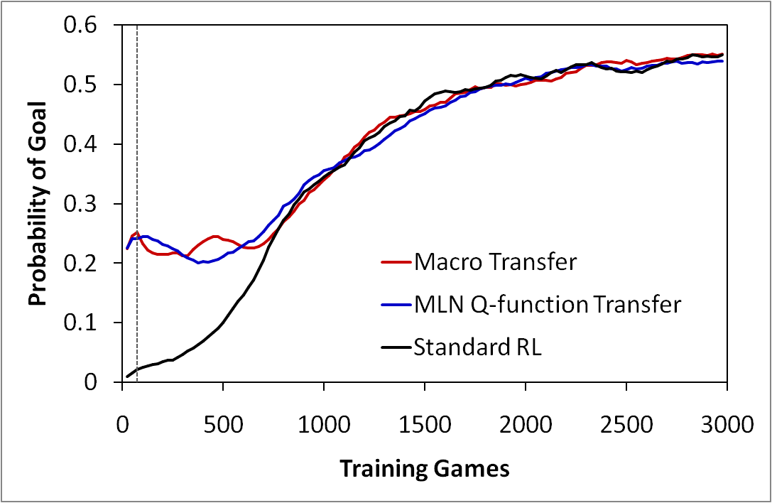
MLN Q-function Results
Transfer from 2-on-1 BreakAway to 3-on-2 BreakAway

Slide 22
Outline
Background
Approaches for transfer in reinforcement learning
Relational transfer with Markov Logic Networks
Two new algorithms for MLN transfer

Slide 23
MLN Policy-Transfer Algorithm
Source
Aleph, Alchemy
MLN Policy
State
Action
MLN
(F,W)
Probability
Demonstration
Target

Slide 24
MLN Policy
move(ahead)
pass(Teammate)
shoot(goalLeft)
…
…
…
…
Policy: choose highest-probability action

Slide 25
Learning an MLN Policy
IF …
THEN pass(Teammate)
IF …
THEN pass(Teammate)
IF …
THEN pass(Teammate)
Formulas for each action: Aleph (Srinivasan)
w₀ = 1.1
w₁ = 0.9
…
Weights: Alchemy (U. Washington)

Slide 26
MLN Policy Rules
Examples for transfer from 2-on-1 BreakAway to 3-on-2 BreakAway
IF angle(topRight, goalCenter, me) ≤ 70
timeLeft ≥ 98
distance(me, Teammate) ≥ 3
THEN pass(Teammate)
IF distance(me, GoalPart) ≥ 36
distance(me, Teammate) ≥ 12
timeLeft ≥ 91
angle(topRight, goalCenter, me) ≤ 80
THEN pass(Teammate)
IF distance(me, GoalPart) ≥ 27
angle(topRight, goalCenter, me) ≤ 75
distance(me, Teammate) ≥ 9
angle(Teammate, me, goalie) ≥ 25
THEN pass(Teammate)

Slide 27
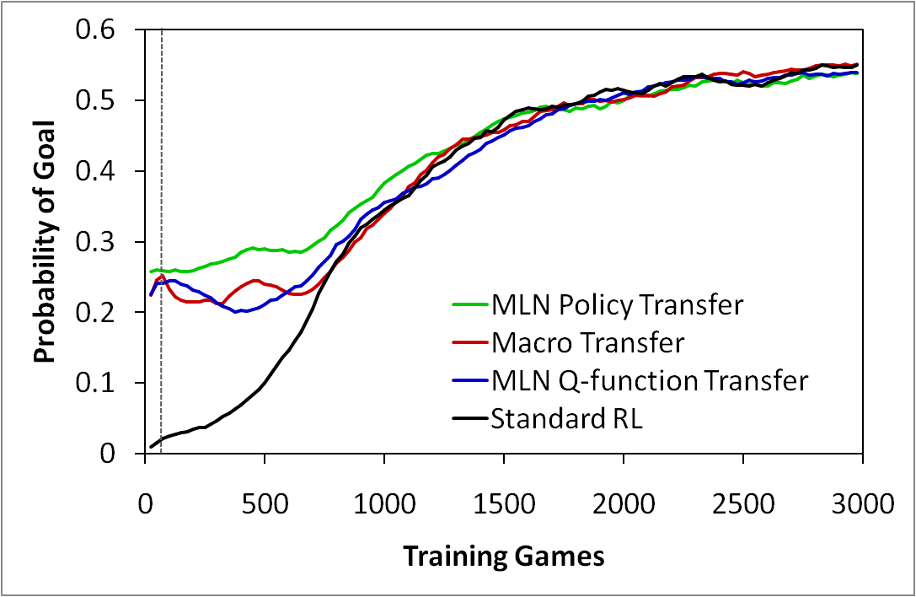
MLN Policy Results
MLN policy transfer from 2-on-1 BreakAway to 3-on-2 BreakAway

Slide 28
Additional Experimental Findings
ILP rulesets can represent a policy by themselves
Does the MLN provide extra benefit?
Yes, MLN policies perform as well or better
MLN policies can include action-sequence knowledge
Does this improve transfer?
No, the Markov assumption appears to hold in RoboCup

Slide 29
Conclusions
MLN transfer can improve reinforcement learning
Higher initial performance
Policies transfer better than Q-functions
Simpler and more general
Policies can transfer better than macros, but not always
More detailed knowledge, risk of overspecialization
MLNs transfer better than rulesets
Statistical-relational over pure relational
Action-sequence information is redundant
Markov assumption holds in our domain

Slide 30
Future Work
Refinement of transferred knowledge
Revising weights
Relearning rules
(Mihalkova et al. 2007)
Too-general
clause
Better
clause
Too-specific
clause
Better
clause

Slide 31
Future Work
Relational reinforcement learning
Q-learning with MLN Q-function
Policy search with MLN policies or macro
MLN Q-functions lose too much information:
Probability
Bin Number

Slide 32
Thank You
Co-author: Jude Shavlik
Grants
DARPA HR0011-04-1-0007
DARPA FA8650-06-C-7606

